Slide 1

Charlie Group
Robert Stewart
Juan Partida-Jacinto
Sean Dudley

Slide 2
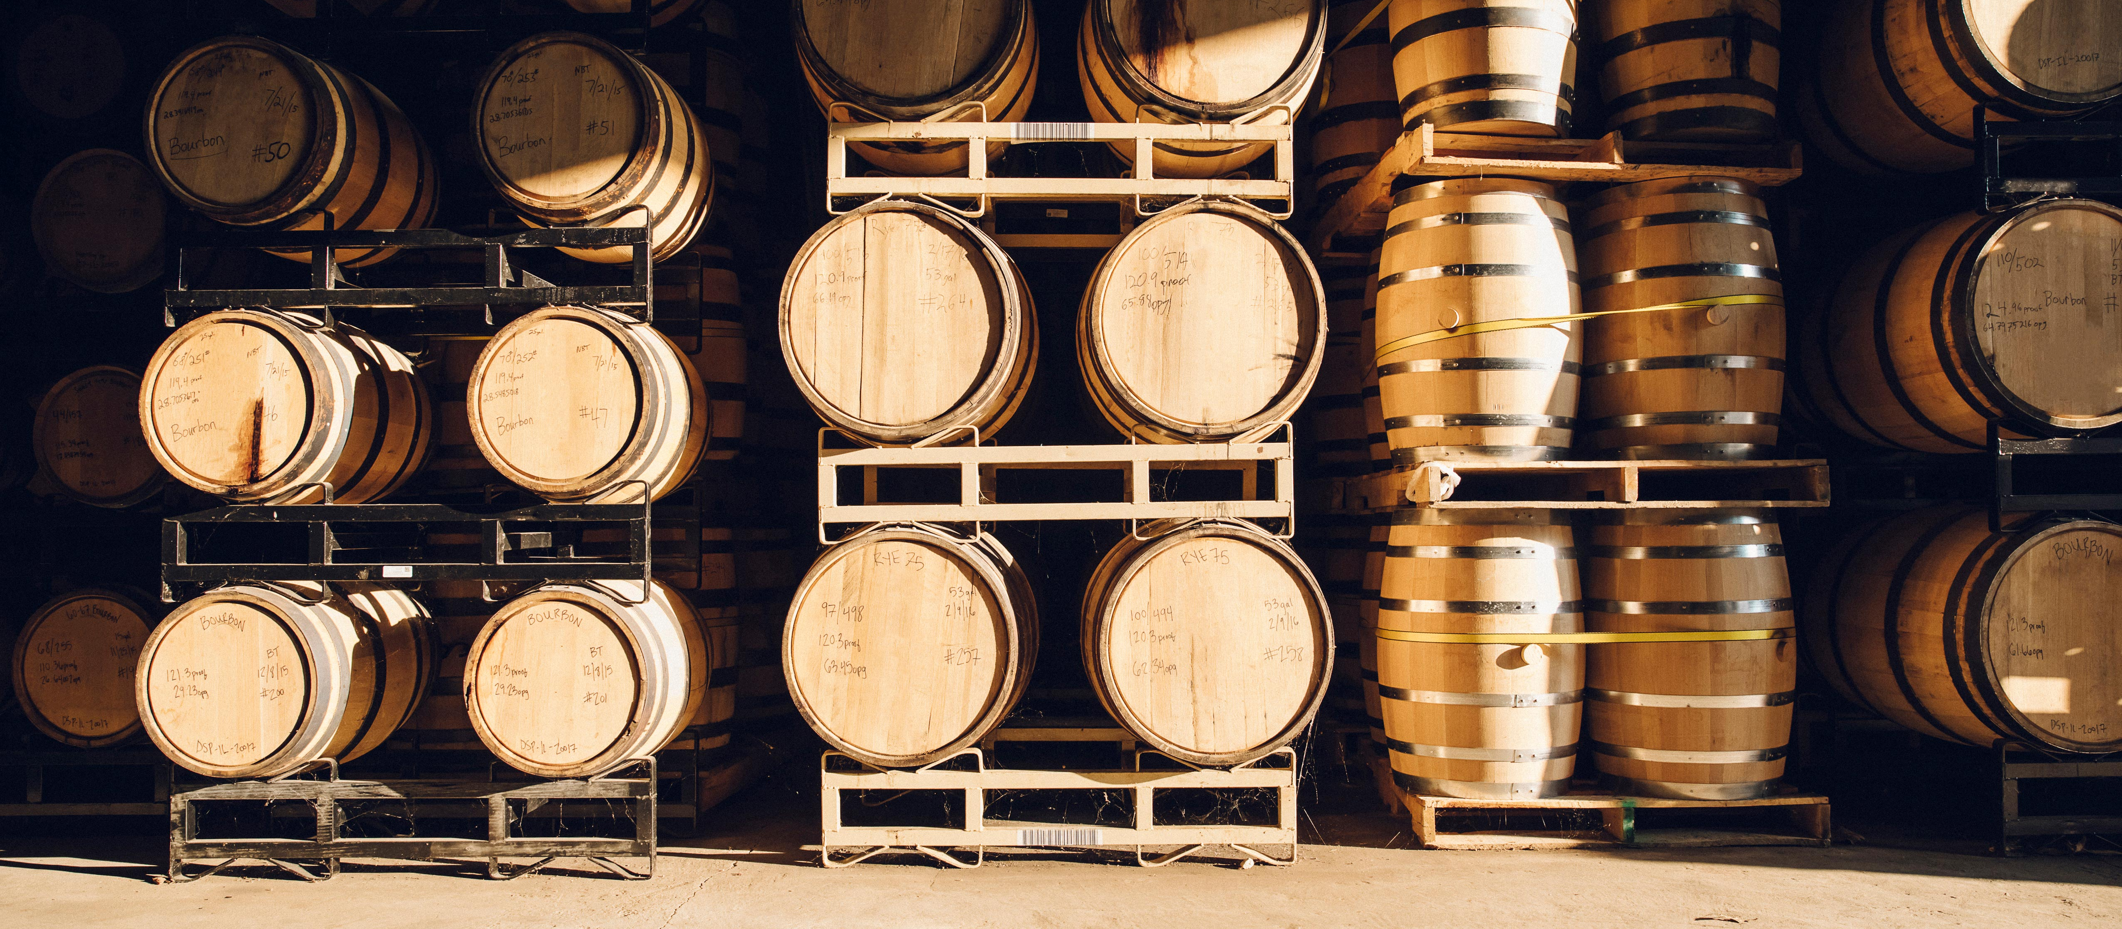
Bacchus Winery Case Study

Slide 3
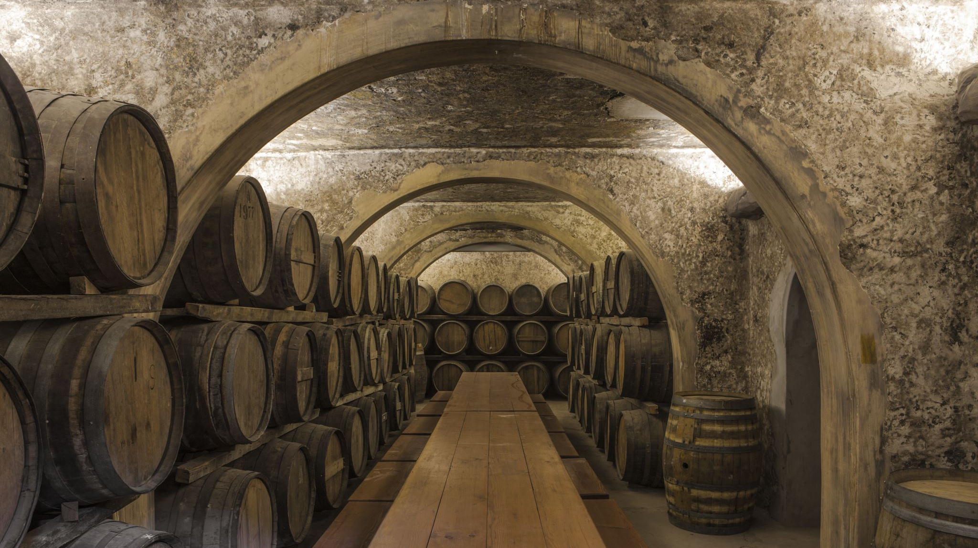
History and Background of Bacchus Winery

Slide 4
Background
Stan and Davis Bacchus inherited the winery from their father, George, and are eager to modernize business practices.
Existing personnel include Janet Collins (finance and payroll), Roz Murphy (marketing), Bob Ulrich (assistant to Roz), Henry Doyle (production manager), and Maria Costanza (distribution).

Slide 5
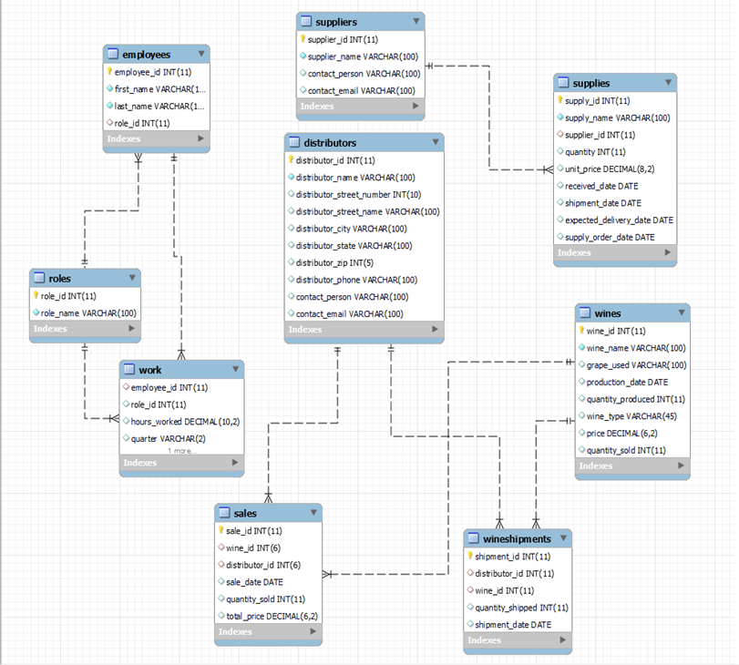
Finalized ERD Diagram

Slide 6

Assumptions
Assumptions:
The winery's existing data management methods need upgrading to support modern business operations.
Online platforms will enhance supply chain and distribution processes.
Detailed reports will provide actionable insights for business decisions.

Slide 7
Key Objectives for Bacchus Winery
Supply Management
Distribution Optimization
Employee Time Tracking
Sales Analysis

Slide 8
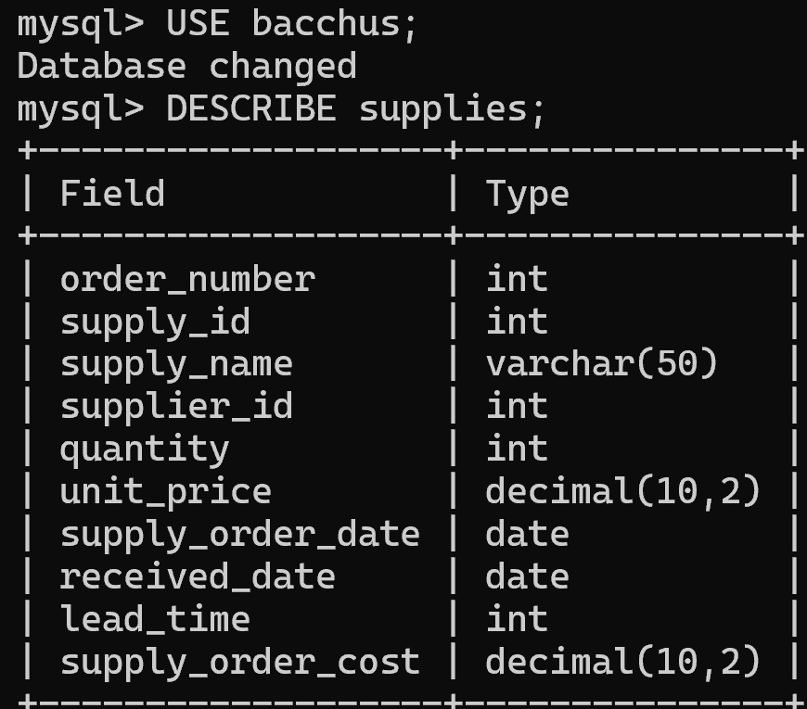
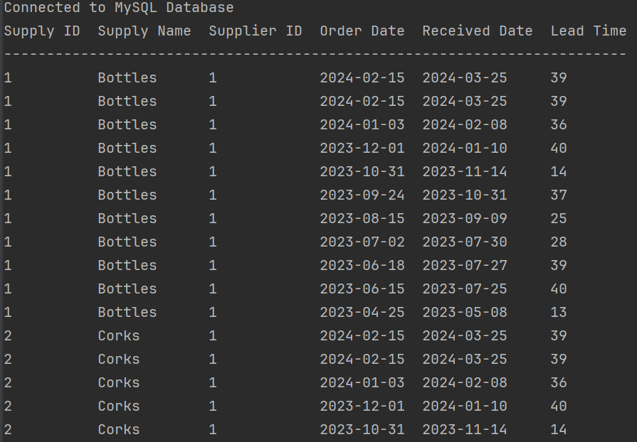
This report lists out each supply that is being purchased. The report shown is a master list of all supply orders. query = "SELECT supply_id, supply_name, supplier_id, supply_order_date, received_date, lead_time FROM supplies" cursor.execute(query) rows = cursor.fetchall()
Report 1

Slide 9
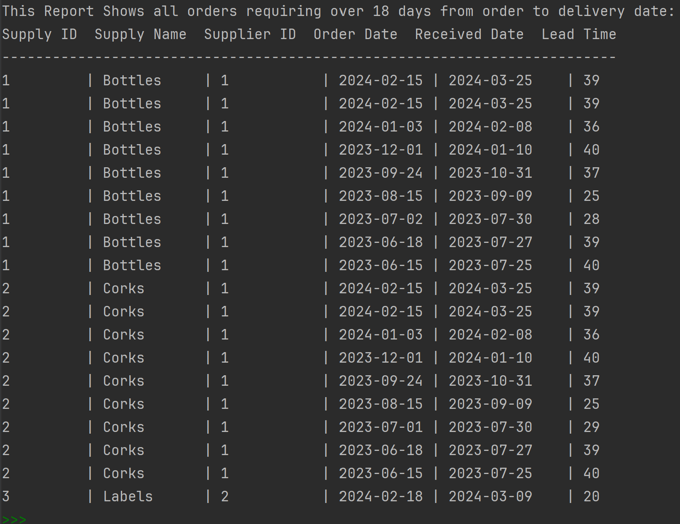
This report has been built to show each supply that has taken 18 or more days from the time of ordering until they were delivered. The Winery is looking at increasing sales, so we much be able to receive our supplies in a timely manner. query_2 = "SELECT supply_id, supply_name, supplier_id, supply_order_date, received_date, lead_time FROM supplies WHERE lead_time >= '18'" cursor.execute(query_2) rows_2 = cursor.fetchall()
Report 1cont.

Slide 10
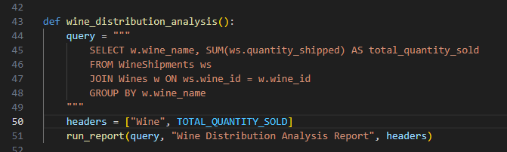
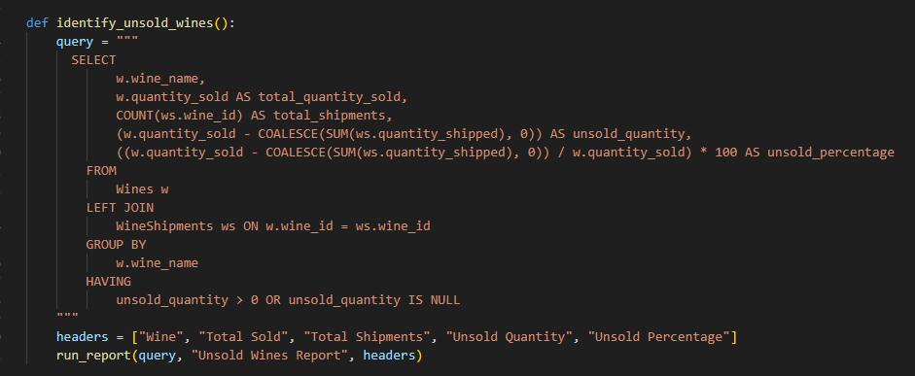
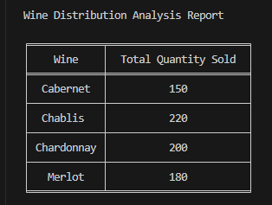
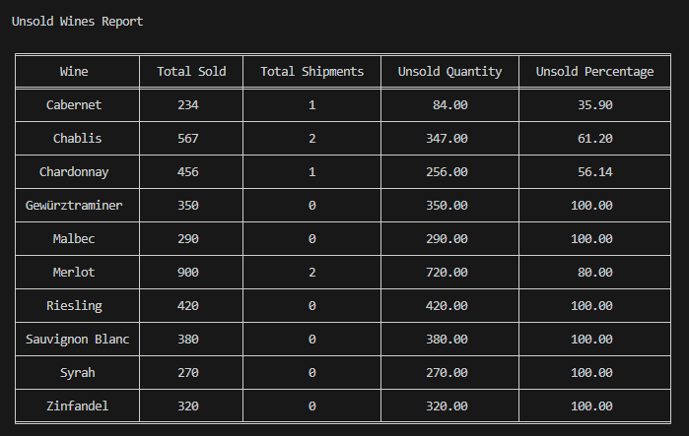
Report 2
Wine Distribution Analysis Report
This report summarizes the total quantity sold for each wine based on shipments.
Python script running the query
Unsold Wines Report
This report identifies wines that have not been fully sold (unsold quantity) and calculates the percentage of unsold wines.
Python script running the query

Slide 11
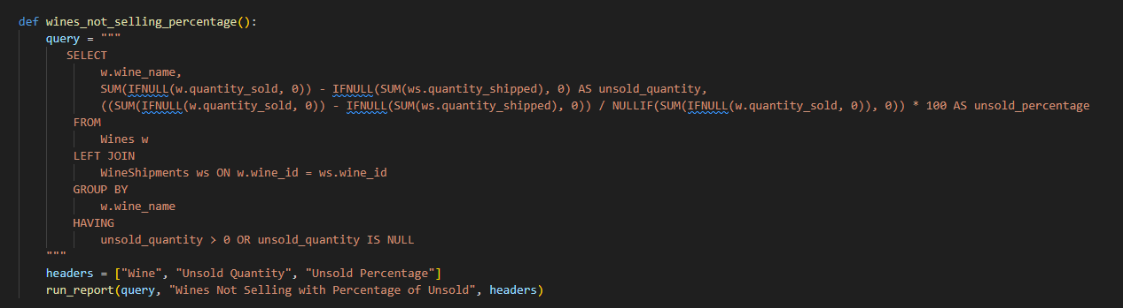
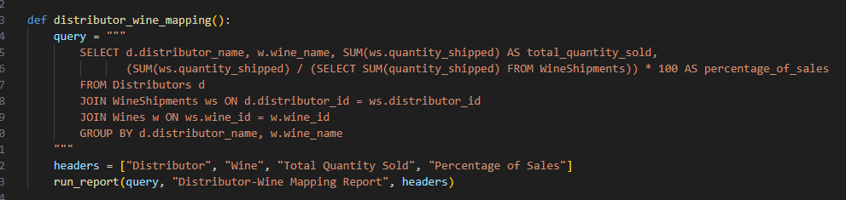
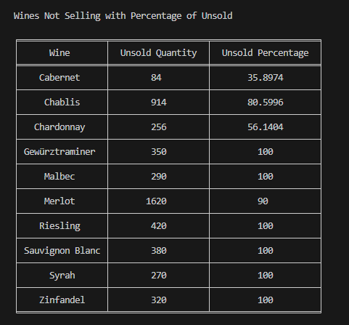
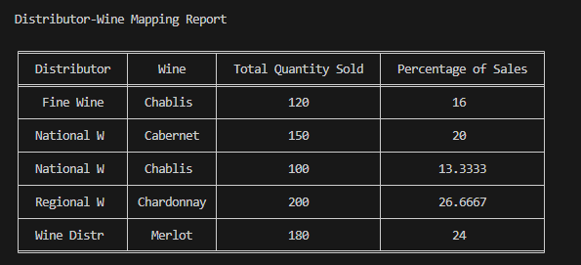
Report 2 cont.
This report shows :
Which wines are not being sold
How many are unsold
Percentage of total wines are unsold
Python script running the query
Wine Distributor Report
This report shows which distributor carries which wine and summarizes the total quantity sold by each distributor for each wine.
Python script running the query

Slide 12
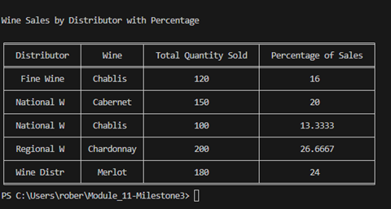
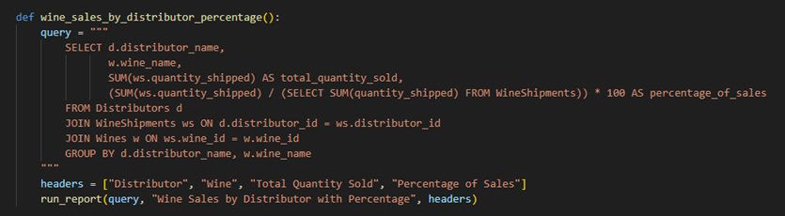
Report 2 cont.
This shows which wines are being sold by which distributors. It also shows the total quantity of a specific wine and percentage of that wine is sold by the same distributor.
Python script running the query

Slide 13
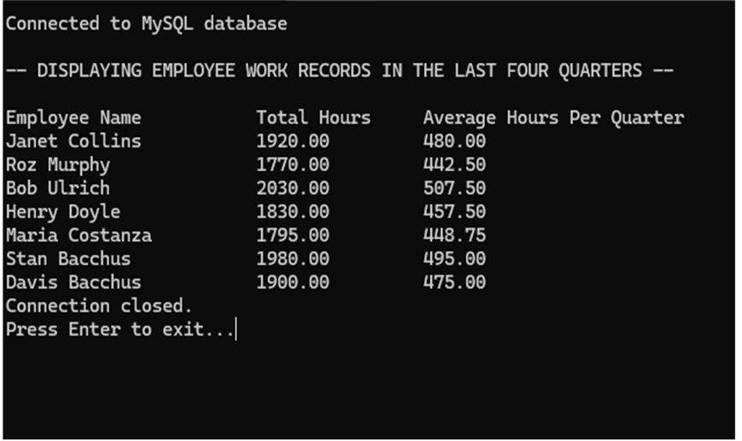
Report 3
Hours Worked Report
Description: This query is useful for getting a clear overview of employee work hours, both total and average per quarter, which can help in assessing planning.
Query: SELECT CONCAT(employees.first_name, ' ', employees.last_name) AS employee_name,
ROUND(SUM(Work.hours_worked), 2) AS total_hours,
ROUND(SUM(Work.hours_worked) / COUNT(DISTINCT Work.quarter), 2) AS average_hours_per_quarter
FROM Work
JOIN employees ON Work.employee_id = employees.employee_id
JOIN (SELECT DISTINCT quarter FROM Work ORDER BY quarter DESC LIMIT 4) AS recent_quarters ON Work.quarter = recent_quarters.quarter
GROUP BY employees.employee_id
LIMIT 0, 400;

